Slide 1
Assistance
Desktop Grid Middleware
a Wasted Computing Power Socialized Reutilization System

Slide 2
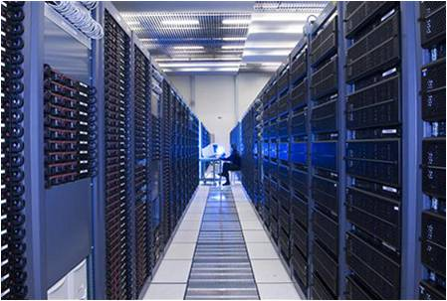
Grid

Slide 3
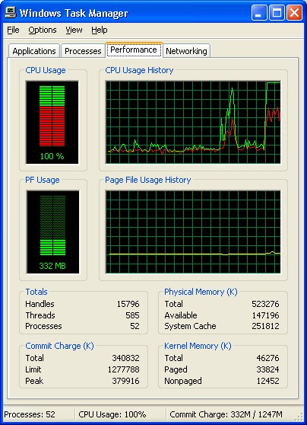
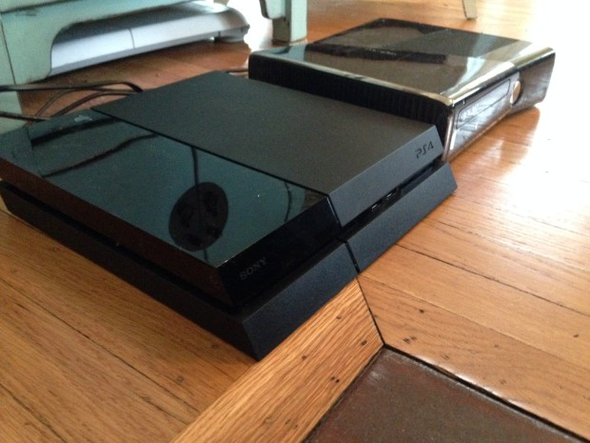
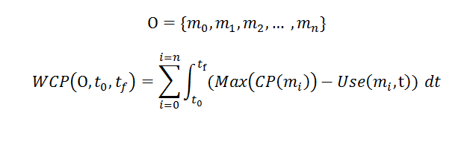
Waste

Slide 4
User’s Code
Initialize;
Do_something();
mapData = new generateMapData();
assistanceQuest1 = Assistance.solveTSP(mapData, NOWAIT);
doSomething();
Assistance.synchronize(this, assistanceQuest1);
doSomething(mapData);
…

Slide 5
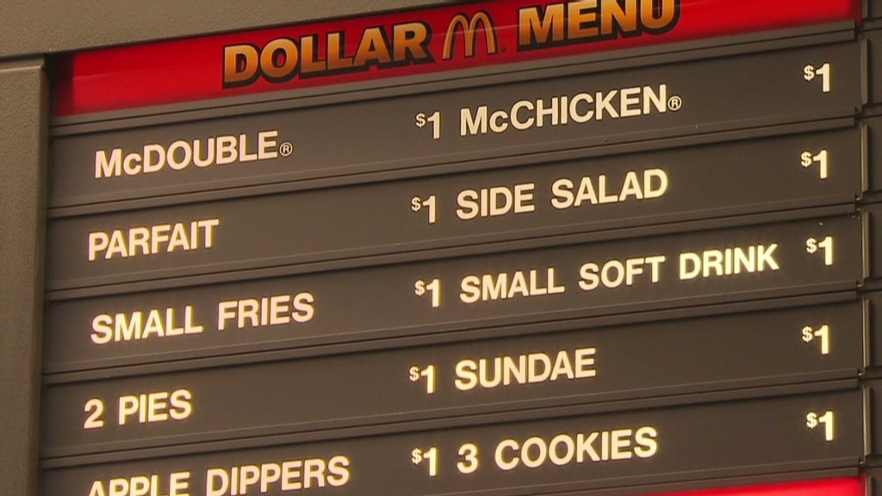
Tasks

Slide 6
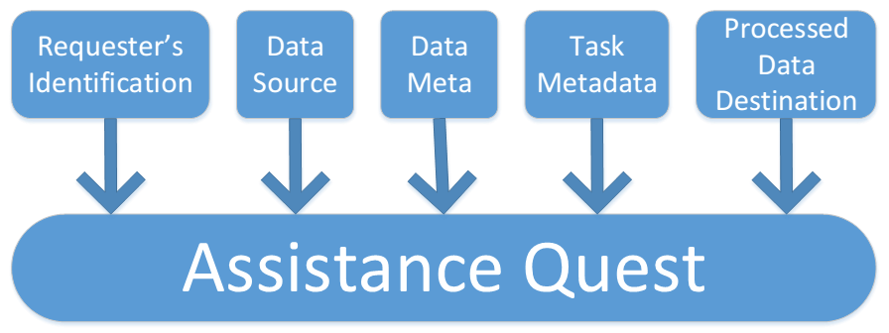
Quest

Slide 7

Optional
Assistance is only given if there are enough resources available.
If more resources are needed, the system automatically stops all Assistance processes.

Slide 8

for everyone to have a Powerful Machine

